Slide 1
Microsoft Power BI

Slide 2
Power BI Dev Camp – Session 6 Developing Custom Visuals for Power BI
Ted Pattison
Principal Program Manager
Customer Advisory Team (CAT) at Microsoft

Slide 3
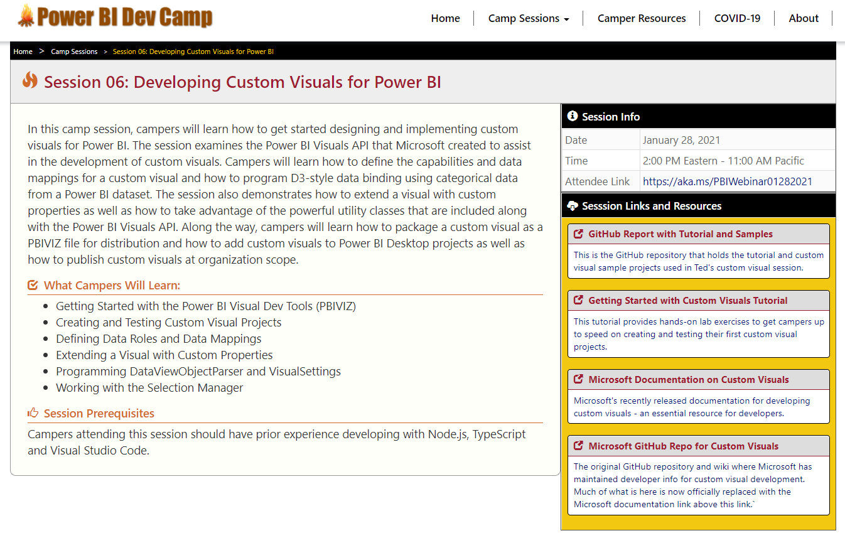
Welcome to Power BI Dev Camp
Power BI Dev Camp Portal - https://powerbidevcamp.net

Slide 4
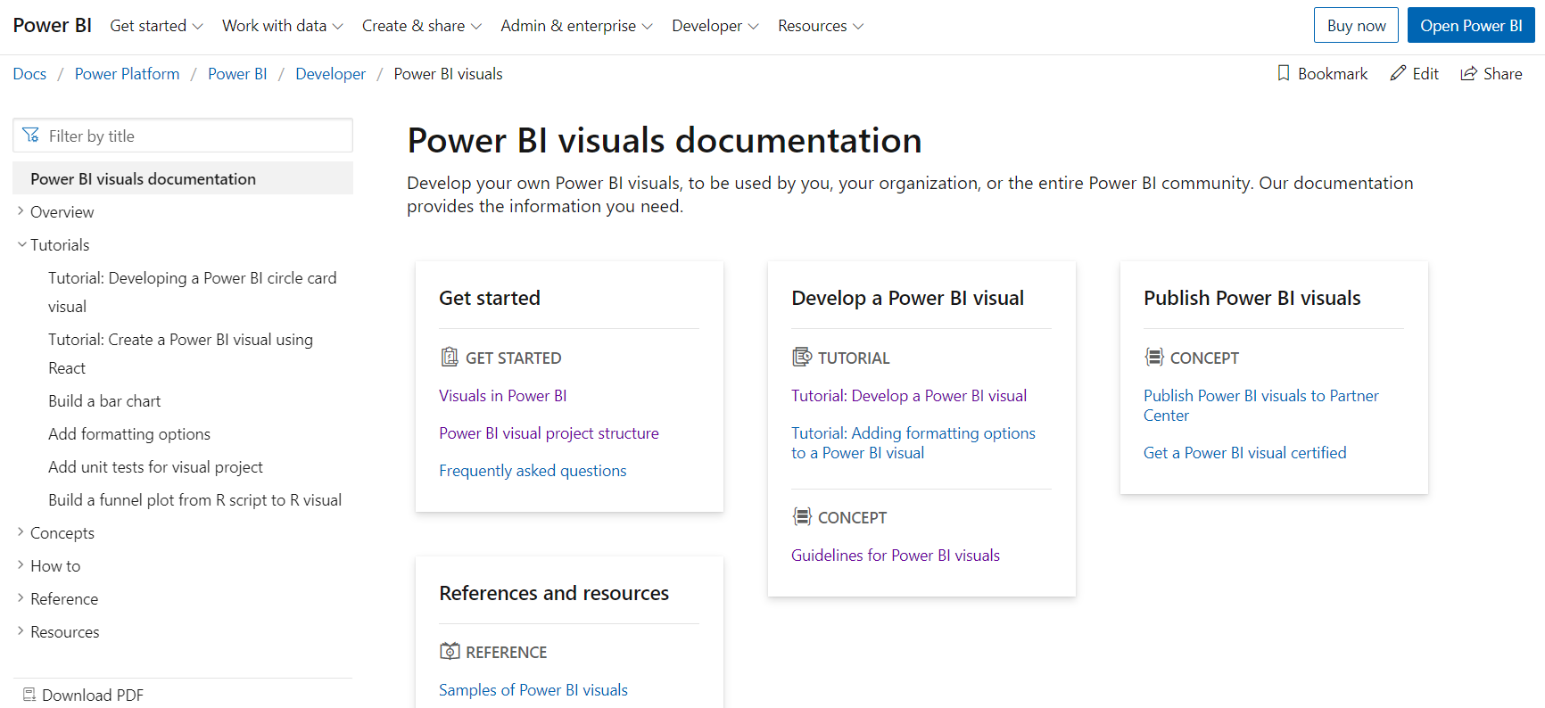
Microsoft Custom Visual Documentation
https://docs.microsoft.com/en-us/power-bi/developer/visuals/

Slide 5
Agenda
Installing the Power BI Developer Tools
Creating Your First Custom Visual
Defining Data Roles and Data Mappings
Extending a Visual with Custom Properties
Implementing Highlighting with SelectionManager
Custom Visual Packaging and Distribution

Slide 6
Installing the Power BI Developer Toolchain
Install Node.JS
Installs Node Package Manage (npm)
Install Visual Studio Code
Lightweight Alternative to Visual Studio for Node.js Development
Install the Power BI Developer Tools (pbiviz)
Install using Node Package Manager (npm)
Create and install a local self-signed certificate
Install using Power BI visuals CLI tool (pbiviz)

Slide 7
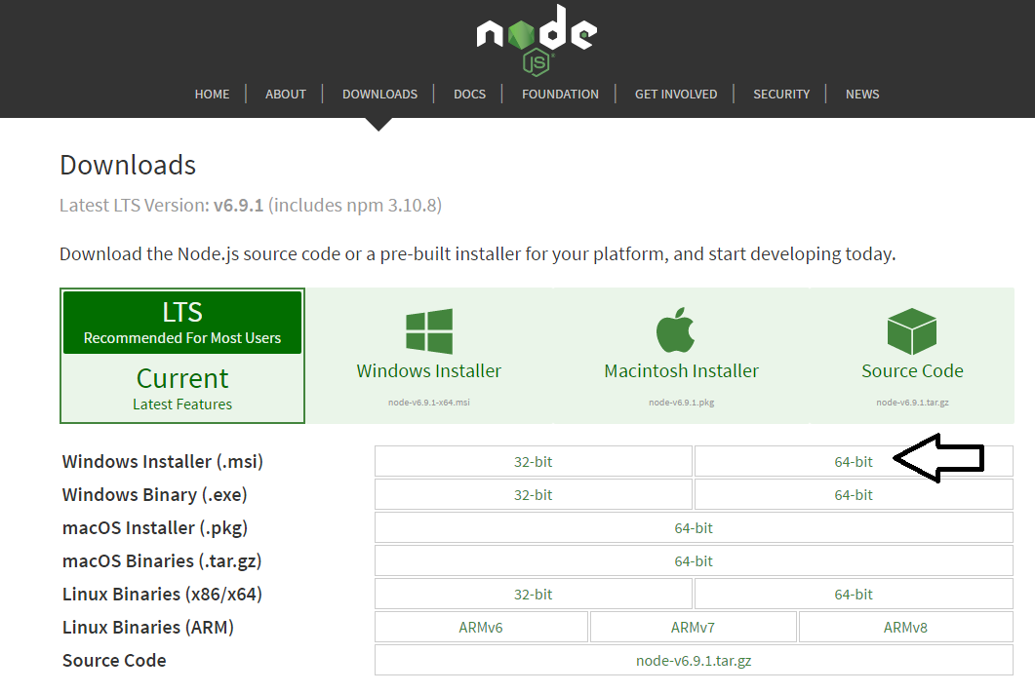
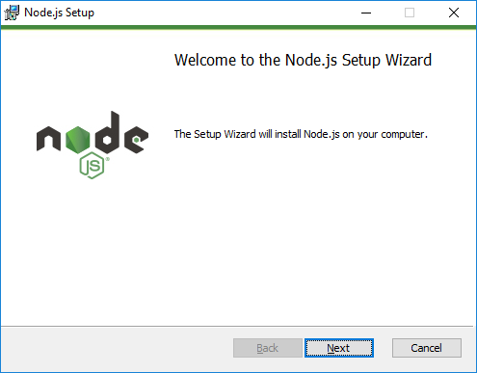
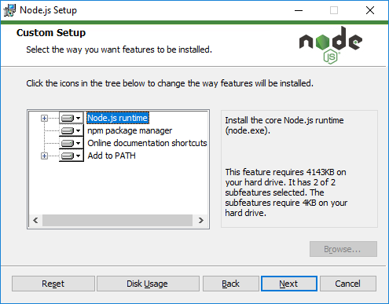
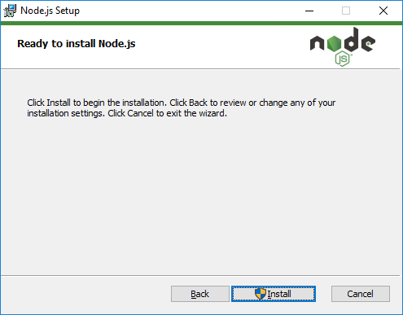
Installing node.js
https://nodejs.org/en/download/

Slide 8
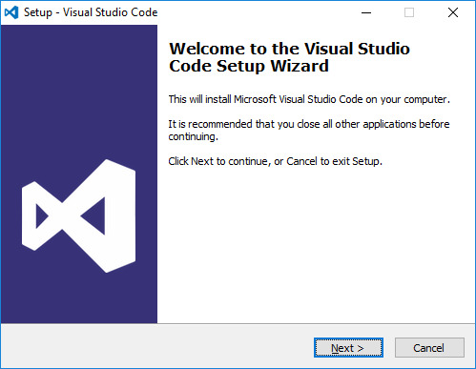
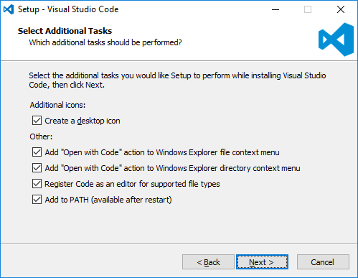
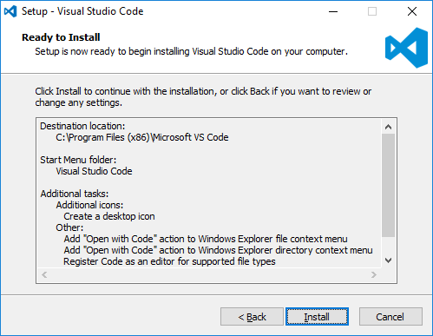
Install Visual Studio Code
http://code.visualstudio.com/

Slide 9
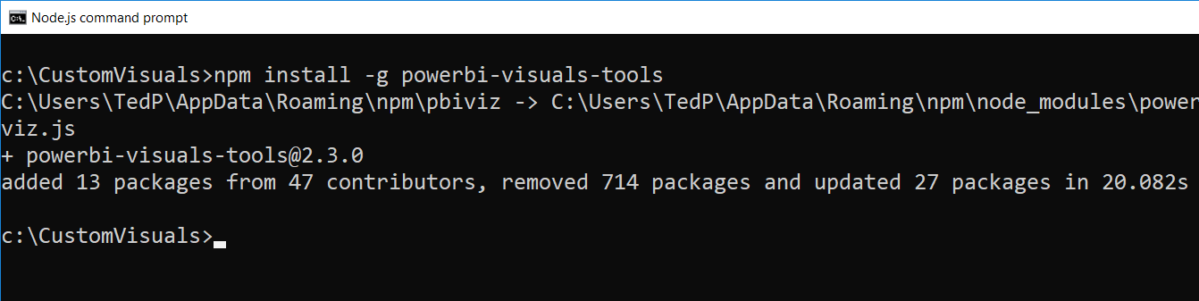
Power BI Visual CLI Tool (PBIVIZ)
What is the Power BI Custom Visual Tool?
Command-line utility for cross-platform dev
Use it with Visual Studio or Visual Studio Code
Requires that you first install node.js
Install by running command from node.js command prompt
npm install -g powerbi-visuals-tools

Slide 10
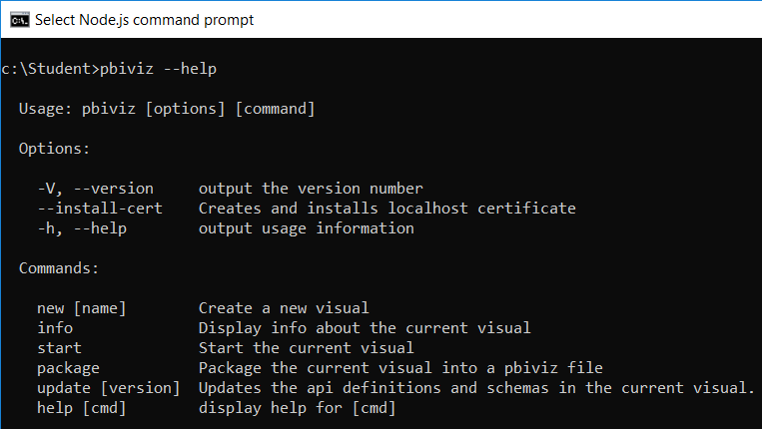
Getting Started with PBIVIZ
PBIVIZ.EXE is a command-line utility
You execute PBIVIZ commands from the NODE.JS command line

Slide 11
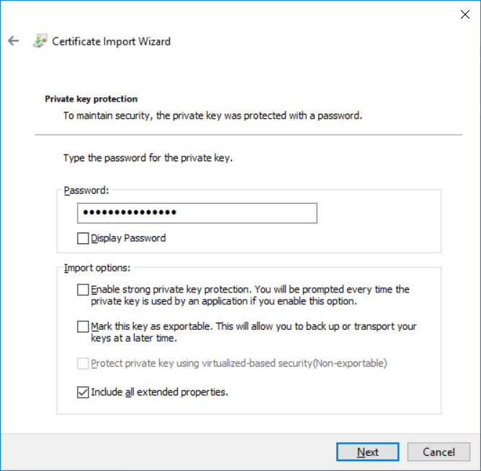
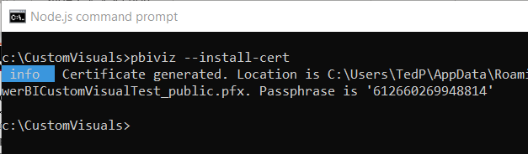
Creating a Certificate for Local Testing
PBIVIZ provide local web server for testing & debugging
Web server runs locally on developer's workstation in Node.js
Makes it possible to test custom visuals in Power BI Service
Custom visual resources served up from https://localhost
Setup requires creating self-signed SSL certificate
SSL certificate created using pbiviz --install-cert command
You must copy a passphrase to properly install the certificate

Slide 12
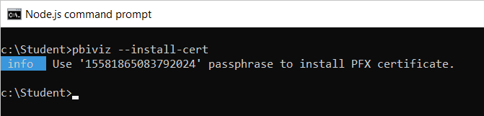
Installing the SSL Certificate
Installing certificate enables SSL through https://localhost
Installing certificate is a one time operation – not once per project
SSL certificate installed using pbiviz --install-cert command
Running --install-cert command starts Certificate Import Wizard

Slide 13
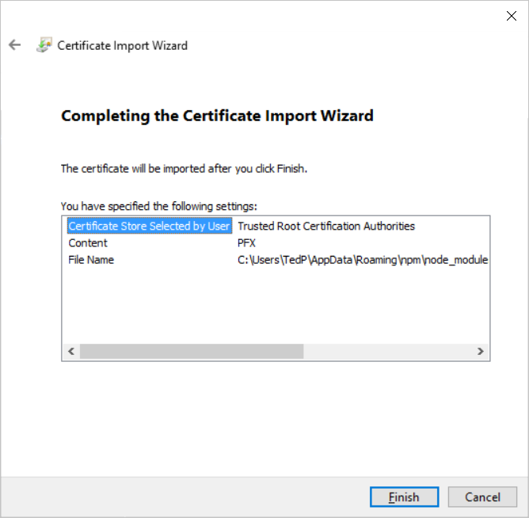
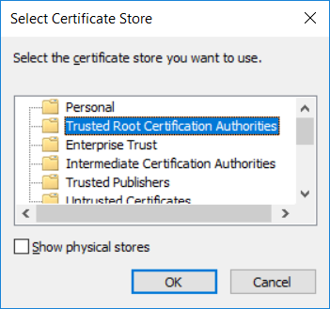
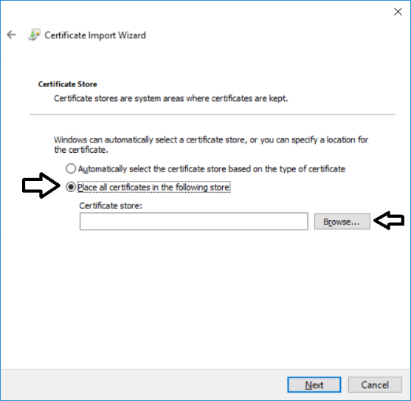
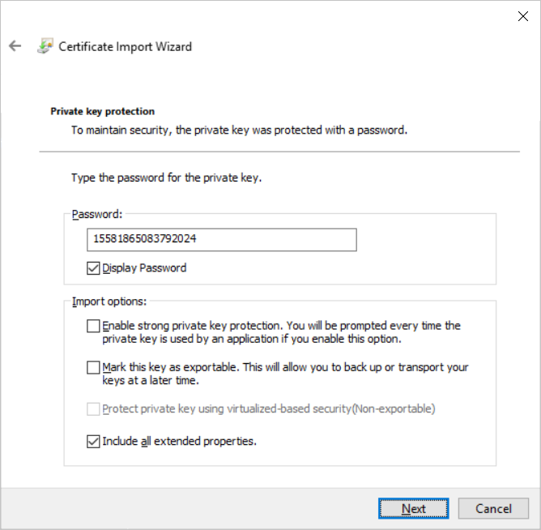
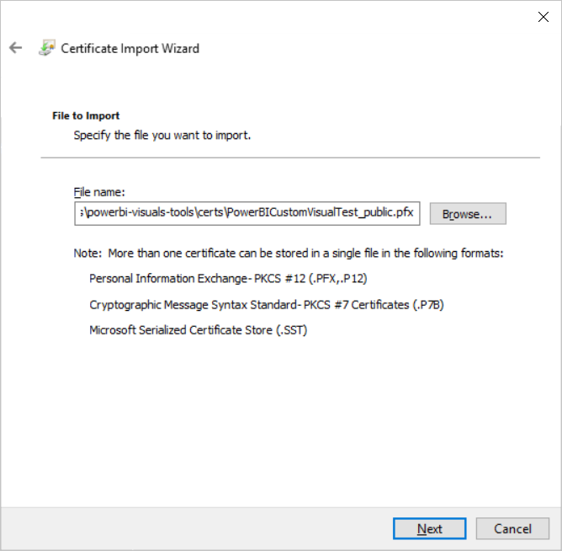
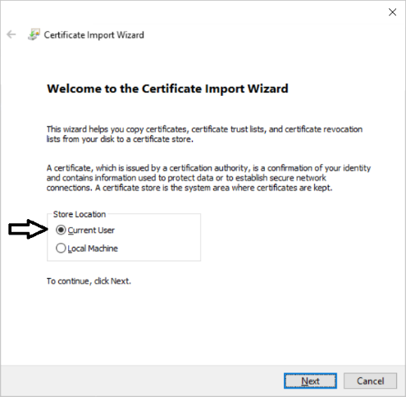
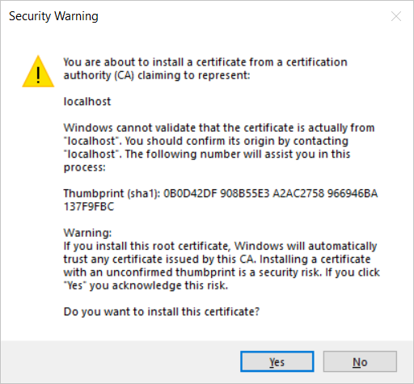
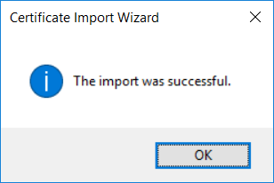
The Certificate Import Wizard
Wizards steps you through process of installing certificate
You enter certificate passphrase as part of installation process

Slide 14
Agenda
Installing the Power BI Developer Tools
Creating Your First Custom Visual
Defining Data Roles and Data Mappings
Extending a Visual with Custom Properties
Implementing Highlighting with SelectionManager
Custom Visual Packaging and Distribution

Slide 15
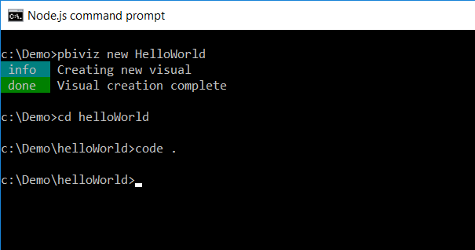
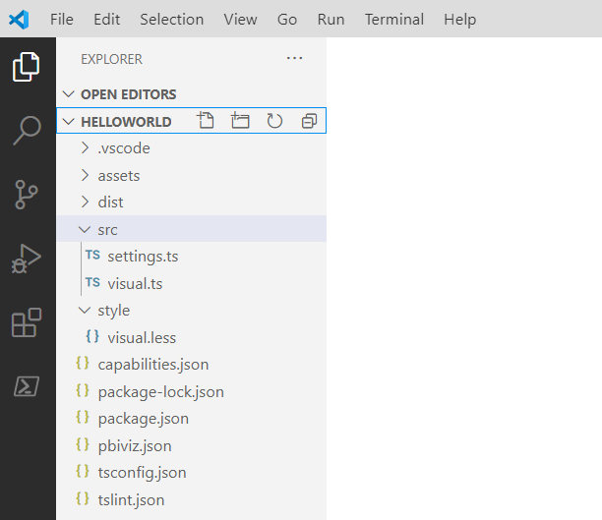
Creating a New Custom Visual Project
Creating a new project
pbiviz new <ProjectName>
Open the Project with Visual Studio Code
code .

Slide 16
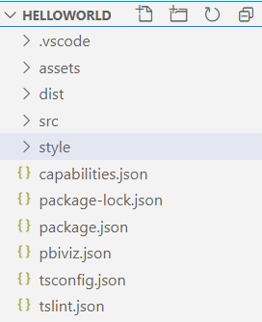
Top-level project files
package.json
Used by npm to manage packages
pbiviz.json
Main manifest file for your custom visual project
capabilities.json
File used to define visual capabilities
tsconfig.json & tslint.json
Typescript compiler settings

Slide 17
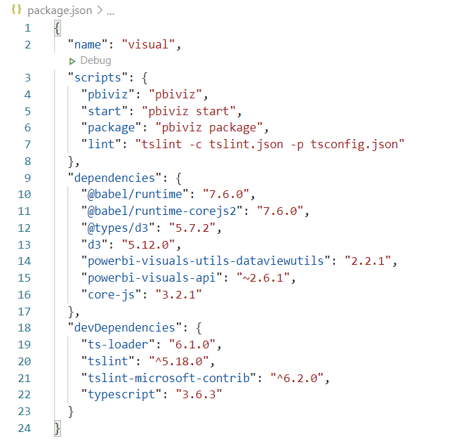
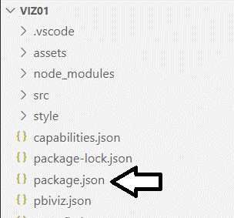
Package.json

Slide 18
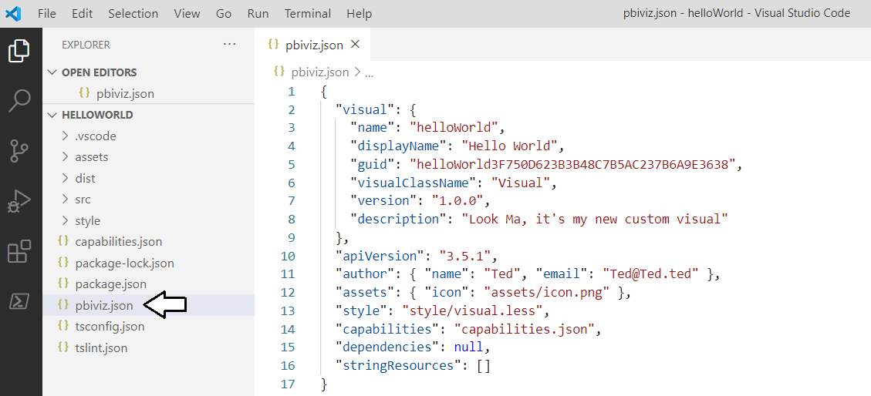
The pbiviz.json File
Acts as top-level manifest file for custom visual project
Contains information used in final visual PBIVIZ packaging process

Slide 19
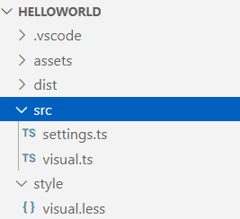
Visual Source Files
src/visual.ts
visual class definition
src/settings.ts
helper class to manage visual properties
style/visual.less
CSS used to style custom visual

Slide 20
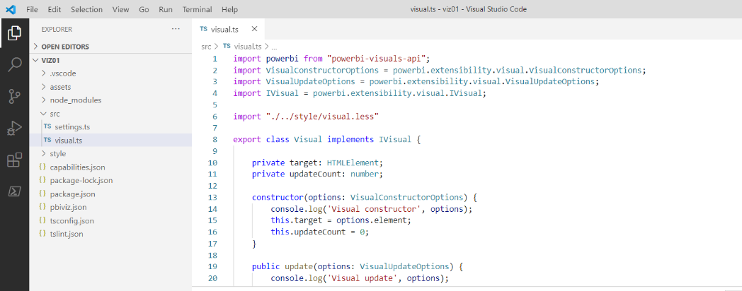
Authoring a Custom Visual Class
Custom visual is a class that implements IVisual
Minimum visual class must implement IVisual interface and provide update method
Parameterized constructor used to create visual elements
update method performs visual rendering

Slide 21
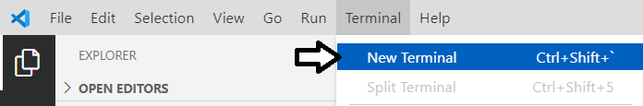
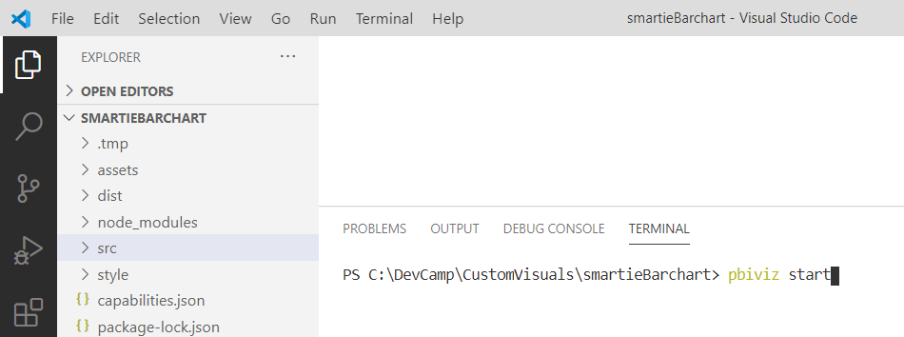
Visual Studio Code Terminal
Use the Terminal to execute commands with npm and pbiviz

Slide 22
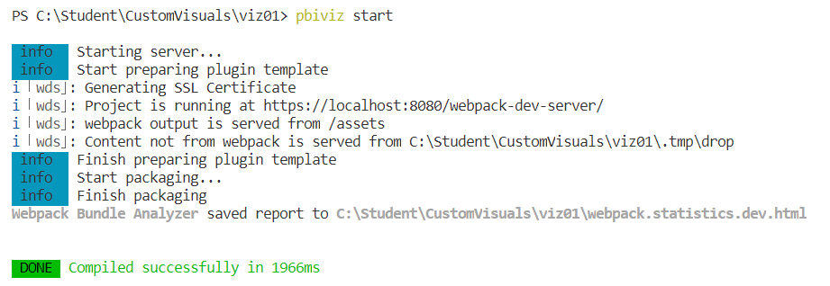
Running a Custom Visual Project
Visual projects run & tested using pbiviz start command
Run pbiviz start from Visual Studio Code from Integrated console
Command starts local debugging session in node.js

Slide 23
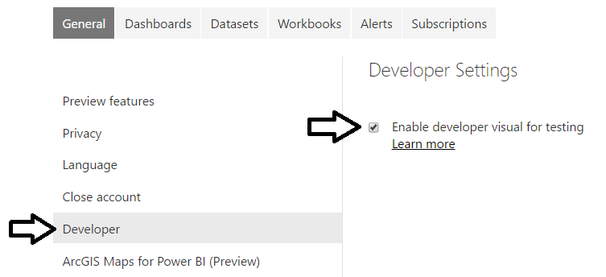
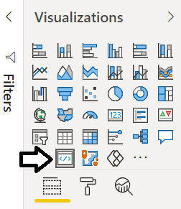

The Developer Visual
Must be enabled on Developer Settings page
Provides new Developer visual for testing and debugging custom visuals

Slide 24
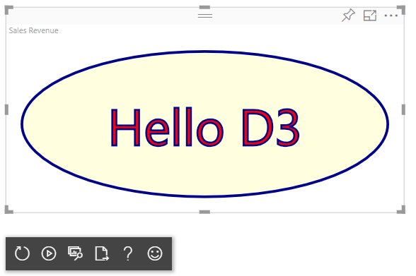
Working with the Developer Visual
Developer visual loads custom visual from node.js
Makes it possible to test custom visual inside Power BI Service
Developer visual provides toolbar with development utilities

Slide 25
Agenda
Installing the Power BI Developer Tools
Creating Your First Custom Visual
Defining Data Roles and Data Mappings
Extending a Visual with Custom Properties
Implementing Highlighting with SelectionManager
Custom Visual Packaging and Distribution

Slide 26
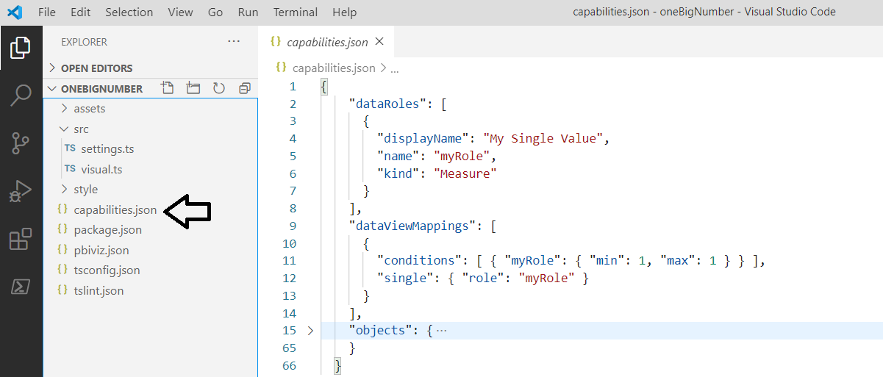
Visual Capabilities
Visual capabilities defined inside capabilities.json
dataRoles define the field wells displayed on Fields pane
dataViewMappings define the type of DataView used by visual
objects created to define custom properties support by visual

Slide 27
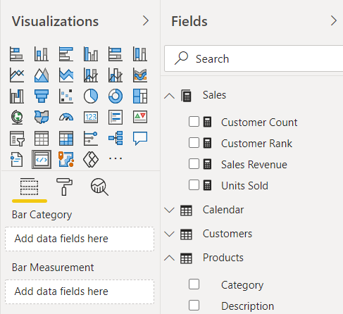
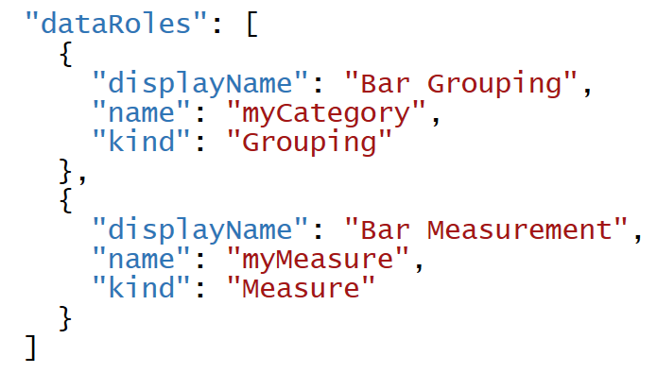
Data Roles
DataRoles define how fields are associated with visual
Each dataRole is display as field well in the Field pane
dataRoles can be defined with conditions and data mappings

Slide 28
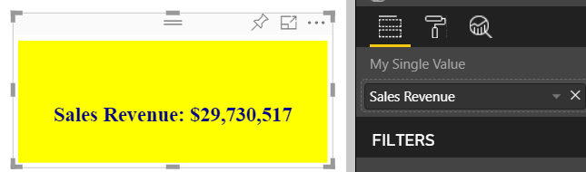
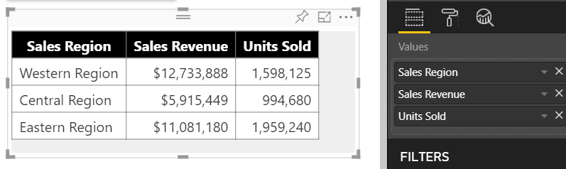
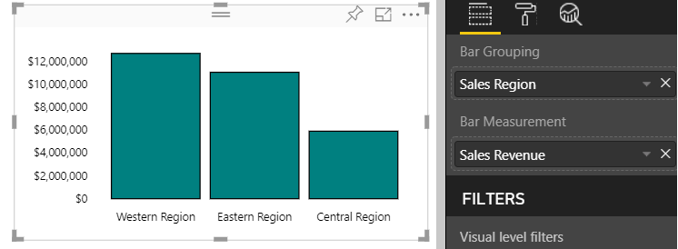
Data Mapping Modes
Power BI visual API provides several mapping modes
Single
Table
Categorical
Matrix
Tree
Single Mapping
Table Mapping
Categorical Mapping

Slide 29
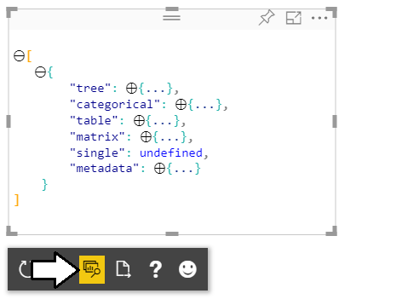
Developer Visual DataView
Developer visual supports DataView mode
Allows you to see and explore data mapping
Allows you to see metadata for custom properties

Slide 30
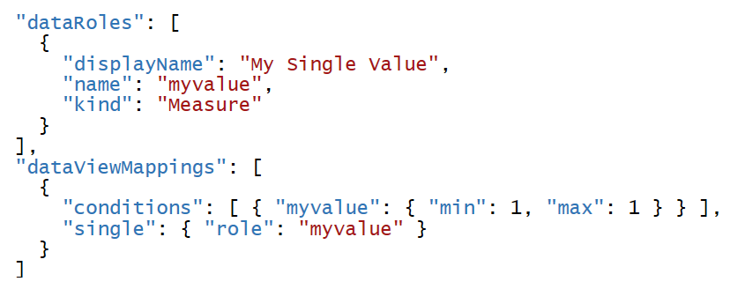
Single Mapping Example: oneBigNumber
dataRole can use dataViewMapping mode of single
For visuals like Card which only display single value
Condition can define that a dataRole requires exactly one measure

Slide 31
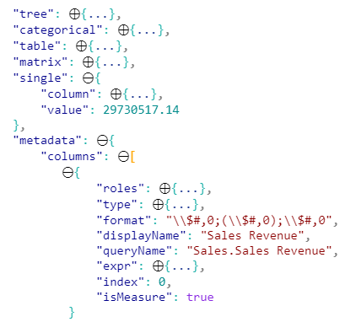
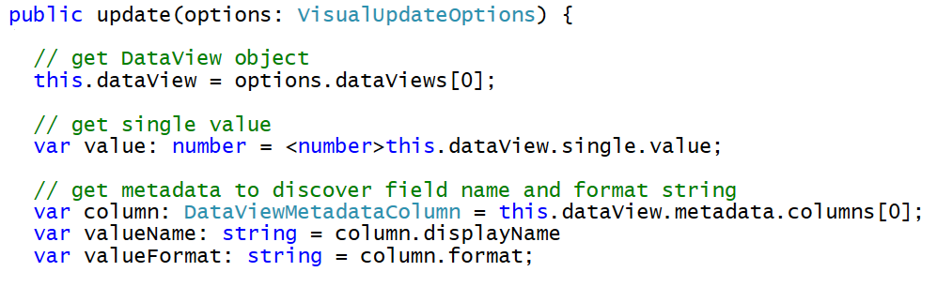
Programming in Single Mapping Mode
Single mapping easy to access through visuals API
DataView object provides single.value property
value property defined as PrimativeValue { bool | number | string }
PrimativeValue must be explicitly cast
Other measure properties available through column metadata

Slide 32
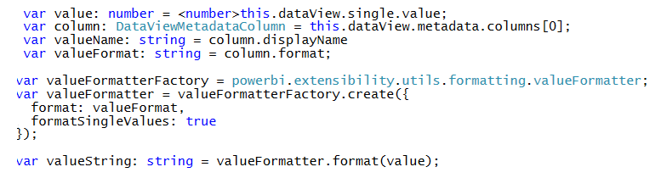
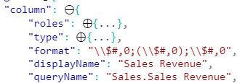
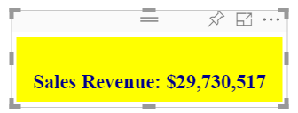
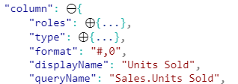

Using the Power BI Formatting Utilities
Used to format values using Power BI formatting strings
Requires installing powerbi-visuals-utils-formattingutils package

Slide 33

Table Mapping Example: Snazzy Table
dataRole can use dataViewMapping mode of table
For visuals which display rows & columns for ordered set of fields
condition can define number of fields that can be added

Slide 34


Programming in Table Mapping Mode
Table mapping data accessible through visuals API
DataView object provides table property
table property provides columns property and rows property

Slide 35

Categorical Mapping Example: Barchart
dataRole can use dataViewMapping mode of categorical
This is the most common type of data mapping
For visuals which divide data into groups for analysis
Groups defined as columns and values defined as measures

Slide 36

Designing with View Model
Best practice involves creating view model for each visual
View model is a collection of data required for rendering visual
createViewModel method acquires data and constructs view model
update method calls createViewModel to get view model

Slide 37
Agenda
Installing the Power BI Developer Tools
Creating Your First Custom Visual
Defining Data Roles and Data Mappings
Extending a Visual with Custom Properties
Implementing Highlighting with SelectionManager
Custom Visual Packaging and Distribution

Slide 38


Extending Visuals with Custom Properties
Custom properties defined using objects
You can define one or more objects in capabilities.json
Each object defined with name, display name and properties
object properties automatically persistent inside visual metadata
properties can be seen and modified by user in Format pane
Custom properties require extra code to initialize Format pane

Slide 39

DataViewObjectParser and VisualSettings
Power BI visual utilities provide DataViewObjectParser
Abstracts away tricky code to initialize and read property values

Slide 40

Mapping Object Properties to VisualSettings
VisualSettings class must map to named objectnamed
VisualSetting class contains named field that maps to object name
Named field based on custom class with mapped properties
Object & property names must match what's in capabilities.json

Slide 41


Initializing Objects in the Format Pane
Visual must initialize properties in Format pane
Visual must implement enumerateObjectInstances
VisualSettings makes this relatively easy
Extra code required to make property appear as spinner

Slide 42


Retrieving Property Values
Property values persisted into visual metadata
Properties not persisted white they still retain default values
Property values retrieved using VisualSettings object

Slide 43
Agenda
Installing the Power BI Developer Tools
Creating Your First Custom Visual
Defining Data Roles and Data Mappings
Extending a Visual with Custom Properties
Implementing Highlighting with SelectionManager
Custom Visual Packaging and Distribution

Slide 44


Implementing Visual Highlighting Support

Slide 45
Agenda
Installing the Power BI Developer Tools
Creating Your First Custom Visual
Defining Data Roles and Data Mappings
Extending a Visual with Custom Properties
Implementing Highlighting with SelectionManager
Custom Visual Packaging and Distribution

Slide 46

Packaging A Custom Visual for Deployment
Use the pbiviz package command to build PBIVIZ file for distribution
Build versioned package for distribution
Build version for testing in Power BI Desktop

Slide 47

Organizational Visuals Gallery
Make custom visuals available on organization-wide basis

Slide 48
Summary
Installing the Power BI Developer Tools
Creating Your First Custom Visual
Defining Data Roles and Data Mappings
Extending a Visual with Custom Properties
Implementing Highlighting with SelectionManager
Custom Visual Packaging and Distribution

Slide 49

Get Ready for Next Month…

Slide 50
Questions

